Slide 1

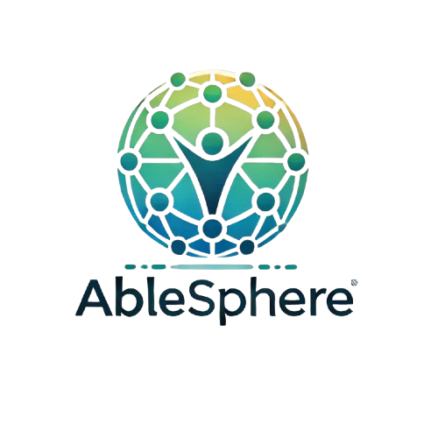


Microsoft Artifical Intelligence (AI) Hackathon PROJECT

Slide 2

About AbleSphere
Vision Statement:
To create a future where every student with special needs has equal access to personalized education, fostering independence, growth, and success through cutting-edge technology and collaboration.
Mission Statement
To empower students with special needs by delivering adaptive, real-time educational support that integrates seamlessly with parents, teachers, and therapists, ensuring inclusivity, accessibility, and compliance with state and federal standards.

Slide 3

Problem Statements
Lack of All-in-One Applications: There are numerous disability focused applications, but very few pull input from multiple sources (Parents, Teachers, Providers).
Widespread Vacancies: 70% of schools reported special education teacher shortages in 2023-24. (K-12 DIVE)
High Turnover: Half of special education teachers leave within five years, disrupting student support. (K-12 DIVE)
Student Impact: Shortages delay critical services like therapy and evaluations, hindering academic growth. (K-12 DIVE)
IEP Process is a qualitative process. The document is usually created using observations, required by the Individuals with Disabilities Education Act (IDEA)

Slide 4
How AbleSphere Empowers Stakeholders
At the core of AbleSphere, accessibility ensures equitable tools and insights for students, parents, teachers, and providers.
Teachers
Parents
Providers
Child
Child: Real-time classroom support, personalized app adjustments, coping strategies, and seamless portability across devices.
Parents: Easy access to child progress insights, actionable recommendations, and tailored resources at the state and federal level.
Teachers: Tools for tracking performance, delivering disability-specific curriculum, and employing intervention strategies with ease.
Providers: Behavioral insights and trends for enhancing therapy and specialized services.
Results: Data-driven recommendations, real-time updates, and seamless collaboration that enhance learning outcomes for students and improve decision-making for stakeholders.

Slide 5
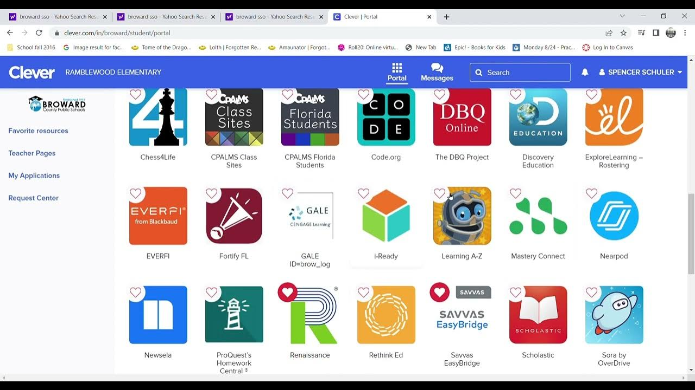
AbleSphere Application Features
Adaptive Learning and Assistance System (ALAS) (Personalized tools, TTS, Visuals aids, Classwork guidance, IOT integration)
IEP Optimization and Recommendation Engine
Resource Navigator and Parent Educator (Support and Collaboration space)
Real-Time Accessibility Checker (Validating websites and Applications for WCAG compliance/suitability)
Multi-Stakeholder Dashboard ( Trends, areas of attention, workflows, etc.)
Clever: Education Application Portal Example
Notes:
AlbeSphere has the five innovative and unique features: Adaptive Learning and Assistance System (ALAS) (Personalized tools, TTS, Visuals aids, Classwork guidance, IOT integration)
IEP Optimization and Recommendation Engine
Resource Navigator and Parent Educator (Support and Collaboration space)
Real-Time Accessibility Checker (Validating websites and Applications for WCAG compliance/suitability)
Multi-Stakeholder Dashboard ( Trends, areas of attention, workflows, etc.)

Slide 6


Tech Stack
Containers
ESP32 Module
Portability and offline access
IOT intergration
ChatGPT API
Vscode/GitHub
LLM Input
Coding
AbleShpere
JS/CSS/Py/Flask
Azure
Architecture
Cloud

Slide 7


AbleSphere Application Scalability
Global Infrastructure for Scalability: Azure’s worldwide data centers ensure AbleSphere delivers reliable, low-latency performance, even in rural or underserved areas.
Secure and Scalable Data Storage: Azure Blob Storage and SQL Database provide reliable and compliant storage for user profiles, IEPs, and activity logs, ensuring data privacy and fast access.
Reliable Offline Functionality: Azure supports offline storage and synchronization frameworks, ensuring AbleSphere works uninterrupted in low-connectivity environments, syncing updates when reconnected.
Advanced Data Analysis for Insights: Azure Machine Learning and Power BI enable real-time and predictive analysis, delivering actionable insights to improve student outcomes and optimize IEPs.

Slide 8

AbleSphere Application Portability
Cross-Device Portability: Azure facilitates seamless syncing of user data across multiple devices and IoT devices, ensuring consistent functionality.
Containerization for Portability: Using Docker or similar container platforms, AbleSphere can be deployed across cloud environments, on-premises servers, or hybrid infrastructures with minimal configuration.
ESP32 IoT Module Integration: ESP32 modules connect IoT devices such as hearing aids, wheelchairs, or heart rate monitors to AbleSphere, enabling real-time monitoring and adaptive responses.
IoT Device Management with Azure IoT Hub: Azure IoT Hub allows ESP32 devices to securely send data to the cloud and receive updates, enabling centralized management and periodic syncing when offline.
Compliance with HIPAA, FERPA, and COPPA: Azure ensures secure uploading and storage of PHI and sensitive student data, meeting strict federal regulations to safeguard privacy and ensure legal compliance.

Slide 9
AbleSphere: Transforming Education Through Accessibility
AbleSphere AI revolutionizes education and accessibility by delivering tailored, real-time support for children with disabilities, empowering parents, equipping teachers, and enhancing providers' impact. Through advanced AI tools, AbleSphere ensures effective IEP optimization, resource access, and personalized learning solutions, meeting the unique needs of every stakeholder.
At the same time, AbleSphere addresses state and federal accessibility requirements by auditing and remediating web content to WCAG standards. This reduces technical challenges and financial burdens for governments while promoting inclusive education and equitable access to critical resources.

Slide 10
Next Steps
Technical Planning:
Design a modular architecture using Azure Cloud or another provider to support offline/online functionality, device integration, and real-time analytics.
Prototype Key Features:
Start with the Real-Time Accessibility Checker and teacher dashboard, focusing on accessibility and usability.
Testing:
Conduct pilot tests in classrooms with varying internet availability to refine features and offline capabilities.
Scaling:
Gradually integrate parent, student, and device features, ensuring a seamless, growing ecosystem

Slide 11

Thank you from Team AbleSphere

